Slide 1
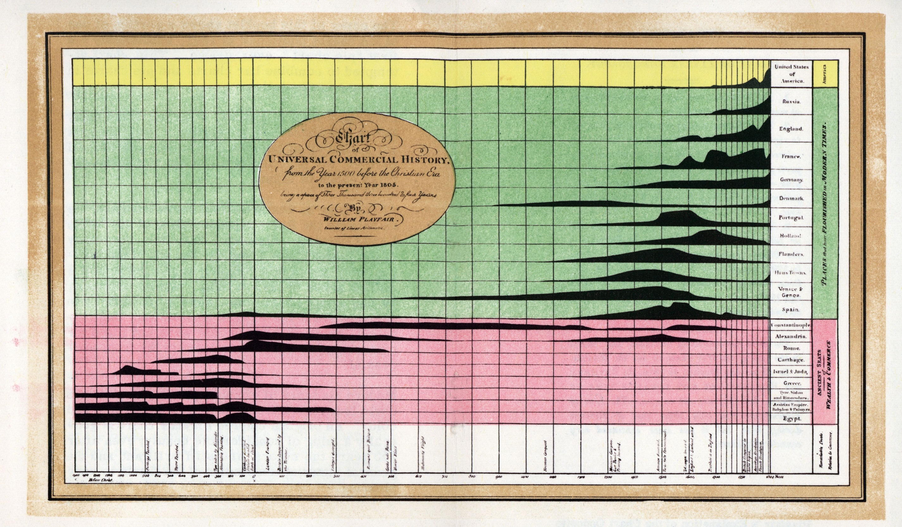
Data Visualization
A History of Visual Thinking & Graphic Communication
Michael Friendly
Howard Wainer

Slide 2
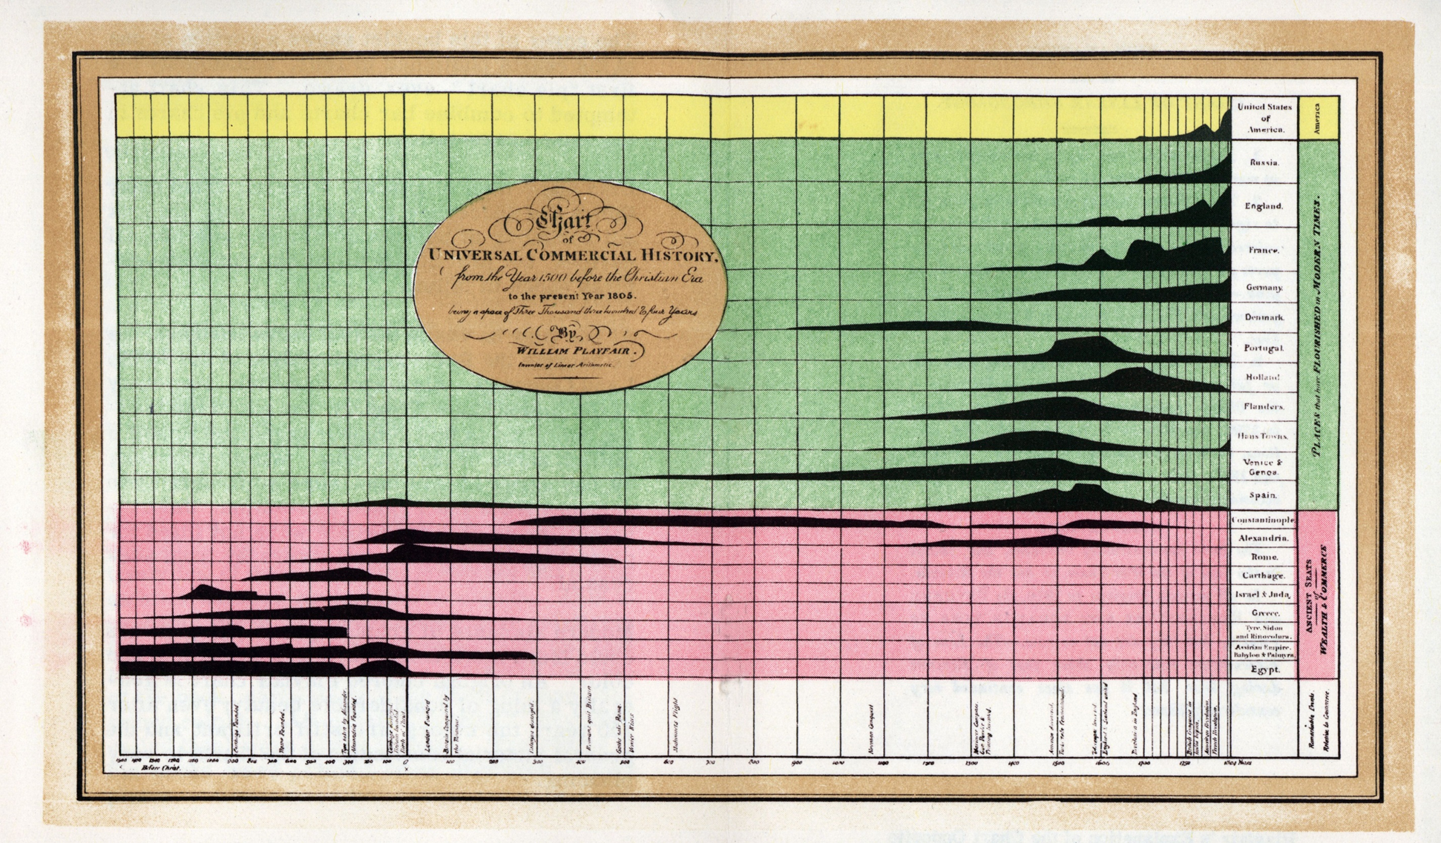
50% transparent
Data Visualization
A History of Visual Thinking & Graphic Communication
Michael Friendly
Howard Wainer

Slide 3
70% transparent
Data Visualization
A History of Visual Thinking & Graphic Communication
Michael Friendly
Howard Wainer

Slide 4
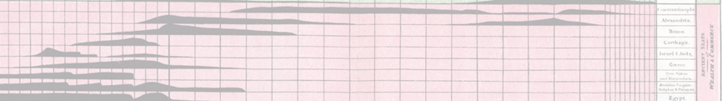
banner
Data Visualization
A History of Visual Thinking & Graphic Communication
Michael Friendly
Howard Wainer

